Slide 1


Spatio-Temporal prediction of sharp increase of cybercrime in India
A Modern Crime of Digital Era
Urvee Patel
N.N. Salghuna

Slide 2

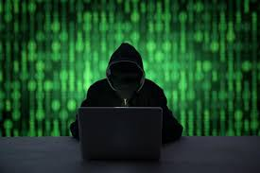
CONTENT
Introduction
Aim & Objective of the study
Study Area
Methodology
Result & Discussion
Conclusion

Slide 3
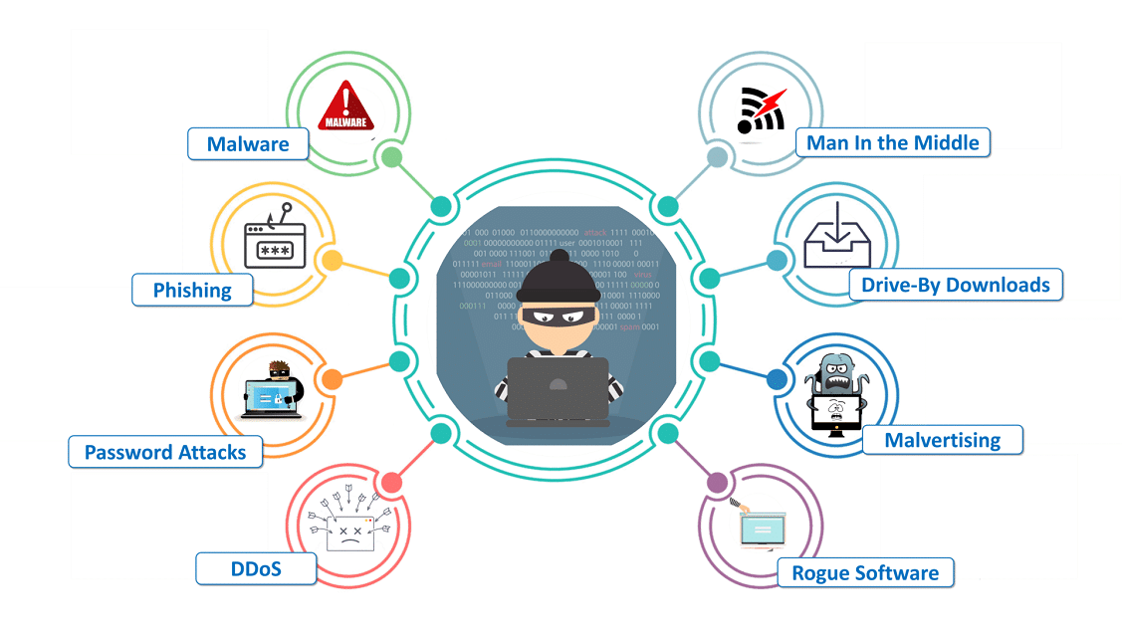
INTRODUCTION
Cybercrime(computer-oriented crime) - offences relating to computers, information technology, internet and virtual reality.
The application of GIS in policing is in rudimentary stage
In recent years, with advances in quick and user-friendly software, manual pin mapping has given way to computerized crime mapping.

Slide 4
INTRODUCTION
In Global ranking for internet users, India stands at second position after china worldwide as per latest report by the Internet & Mobile Association of India (IAMAI) 2019
The Internet Crime Report for 2019, released by USA’s Internet Crime Complaint Centre (IC3) of the Federal Bureau of Investigation, has revealed that India stands third in the world among top 20 countries that are victims of internet crimes.
Cyber Intrusions and Attacks have increased dramatically over the last decade, exposing sensitive personal and business information, disrupting critical operations, and imposing high costs on the economy
Digital India may have become a soft target for criminals as country recorded a huge increase of 63.5 percent in cyber crime cases in the year 2019, showed the National Crime Record Bureau data.

Slide 5
AIM
The study aims to predict a growth in number of cybercrime cases across India in year 2020 based on historical data from 2016-19 using spatio-temporal maps to visualise and further analyse the significant changes.
PURPOSE
The study can help understand the role of GIS in crime analysis, ultimately benefitting the humankind in long run.
There is a felt need for the fullest application of GIS technology in law enforcement agencies

Slide 6
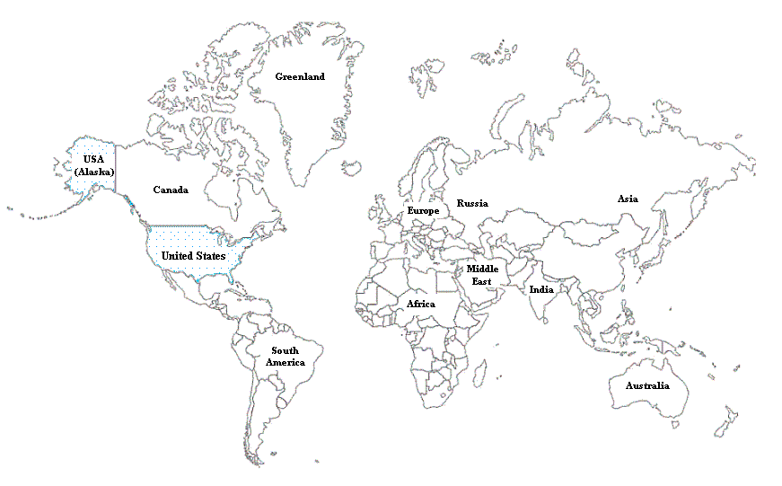
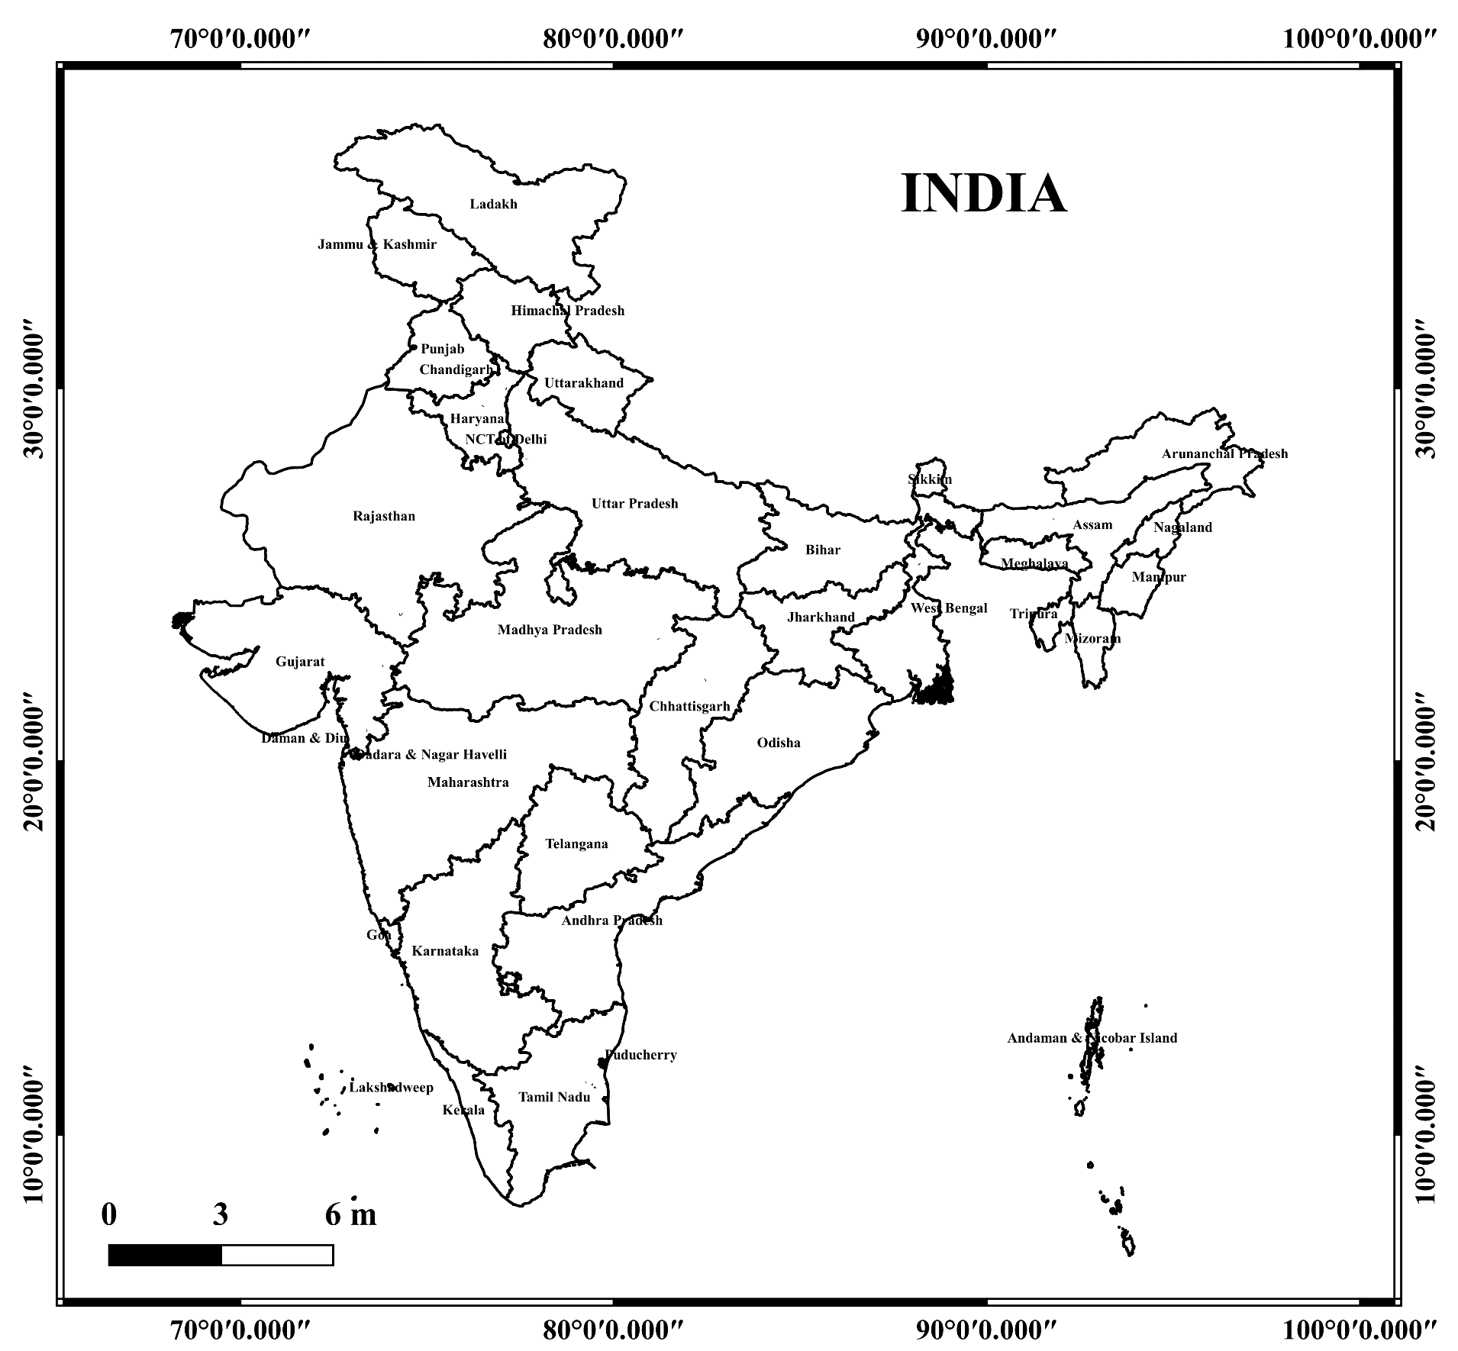
Study Area

Slide 7
M ETHODOLOGY
Data Collection
Cybercrime data 2016 – 2019
2020 Forecast
Calculation of Forecast values using Exponential Triple Smoothening Method
IDW Analysis
IDW Interpolation analysis
Interpolated GIS maps generation
India administrative shapefile
Preparation of graphs

Slide 8

RESULTS & DISCUSSION

Slide 9
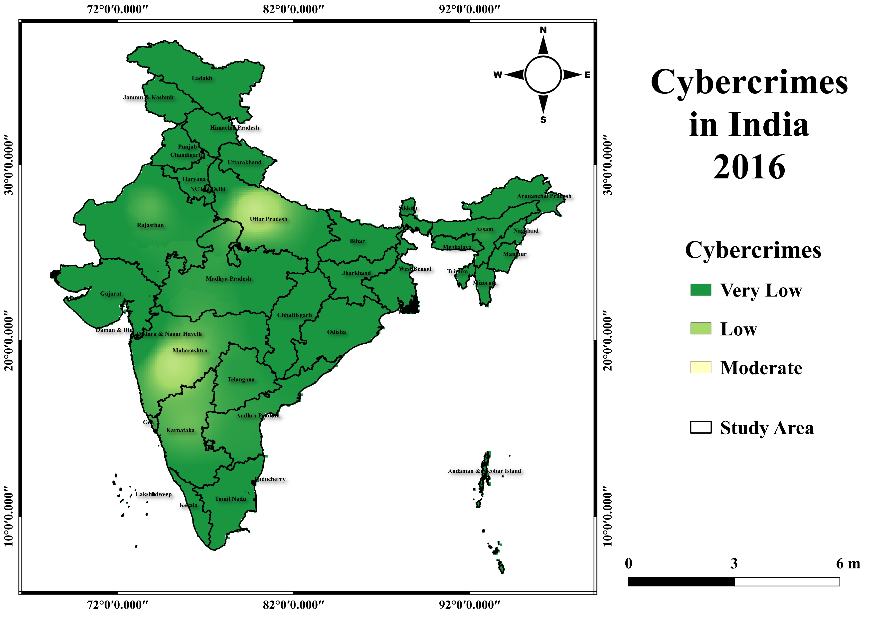
Interpolated map for the year 2016 showing cyber crime values ranging from 0 to 2639
For the purpose of the study, total values were divided in 5 classes as follows:
0-500: Very Low
500-1500: Low
1500-5000: Moderate
5000-8000: High
Above 8000: Very High

Slide 10
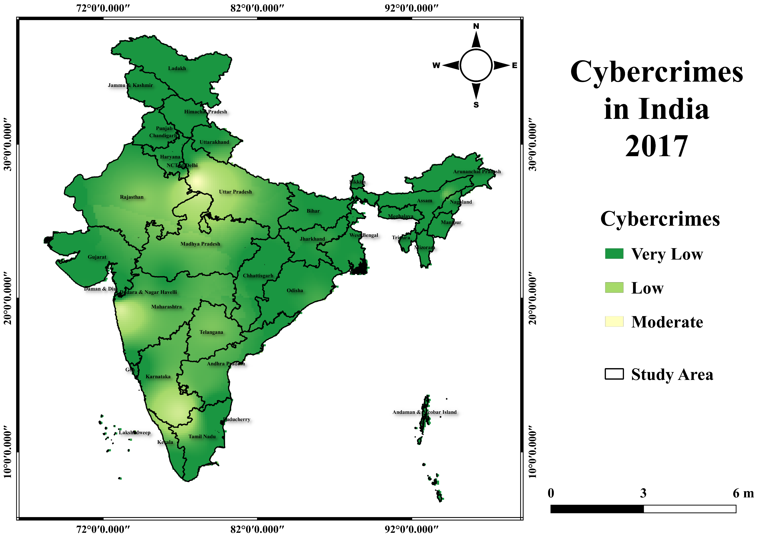
For the purpose of the study, total values were divided in 5 classes as follows:
0-500: Very Low
500-1500: Low
1500-5000: Moderate
5000-8000: High
Above 8000: Very High
Interpolated map for the year 2017 showing cybercrime values ranging from 0 to 4971

Slide 11
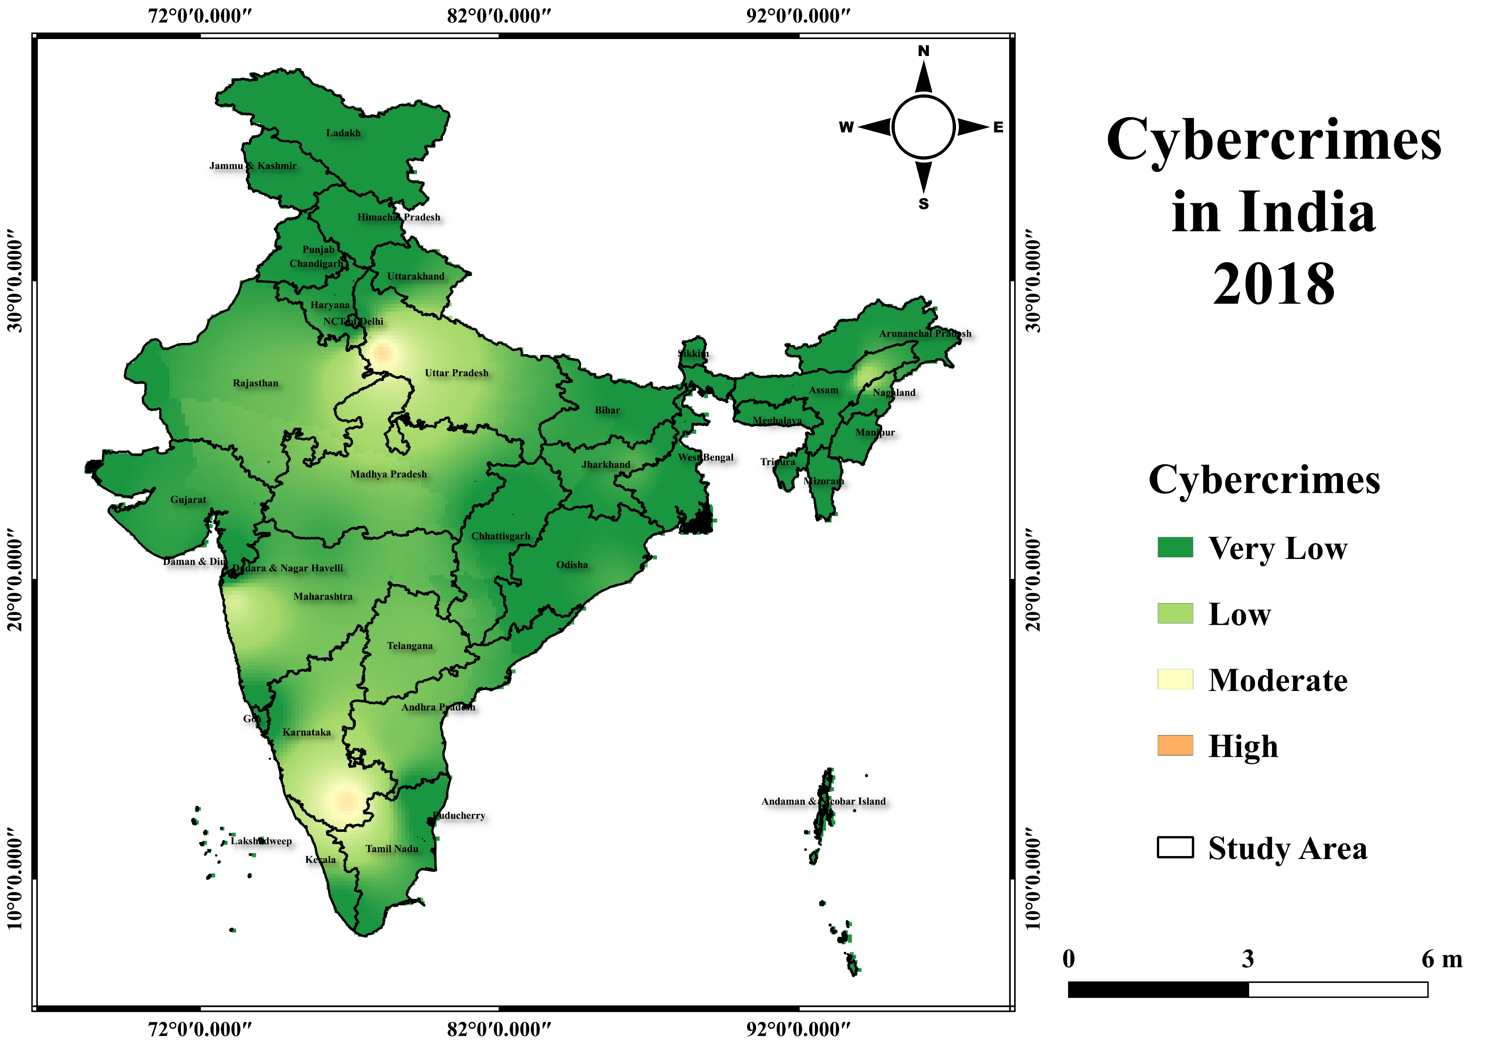
Interpolated map for the year 2018 showing cyber crime values ranging from 0 to 6280
For the purpose of the study, total values were divided in 5 classes as follows:
0-500: Very Low
500-1500: Low
1500-5000: Moderate
5000-8000: High
Above 8000: Very High

Slide 12
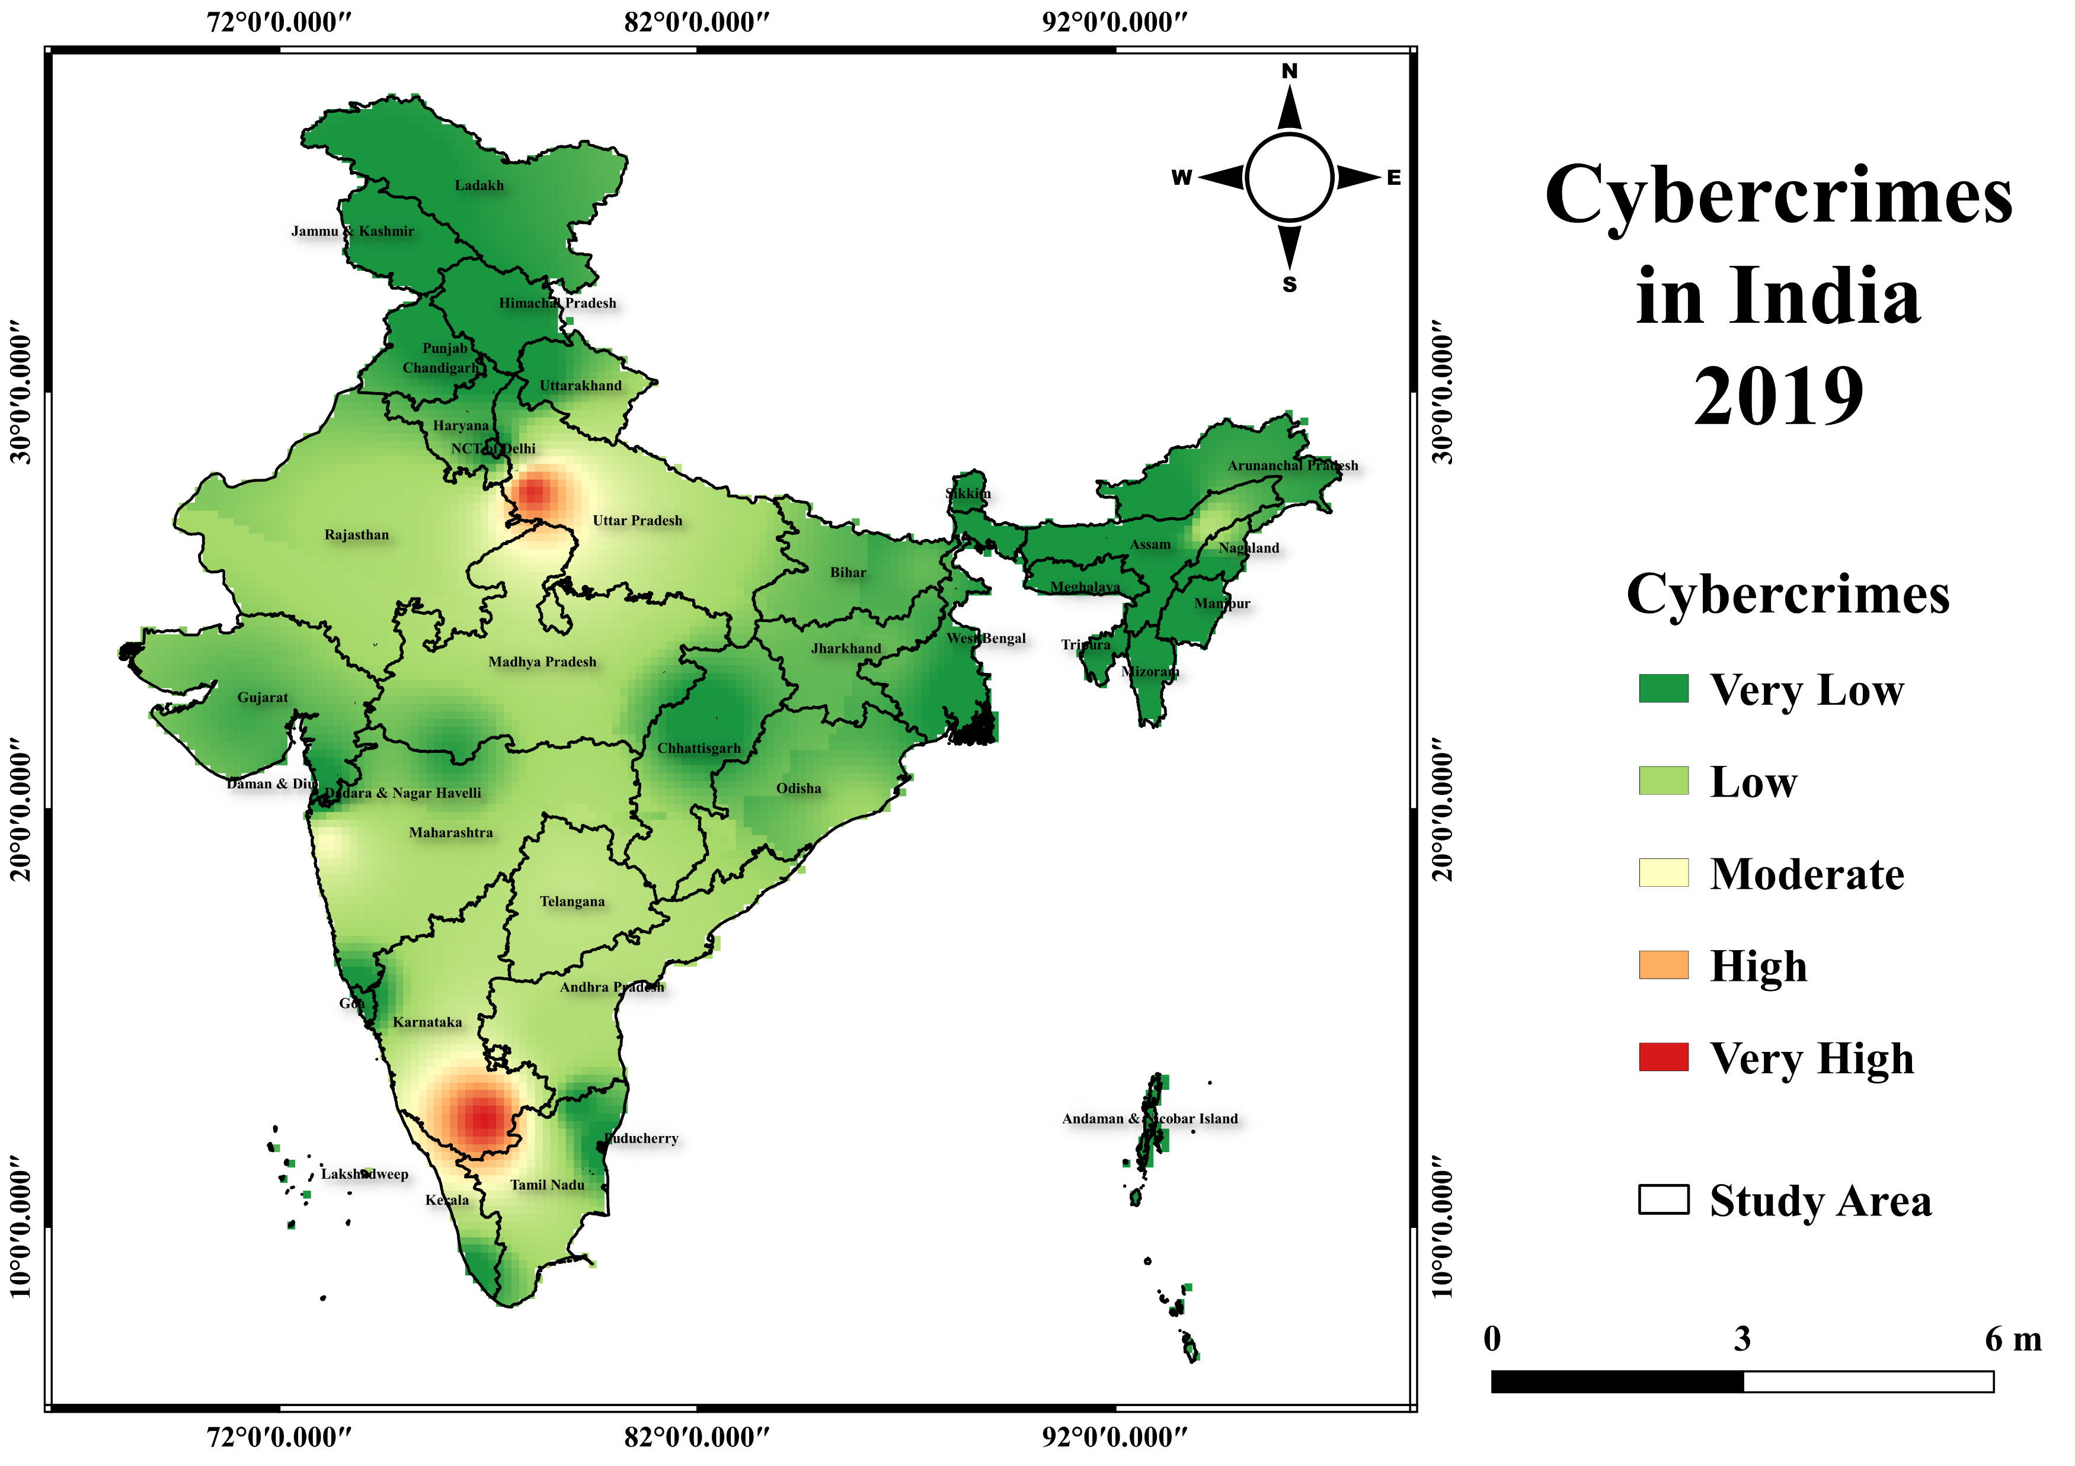
For the purpose of the study, total values were divided in 5 classes as follows:
0-500: Very Low
500-1500: Low
1500-5000: Moderate
5000-8000: High
Above 8000: Very High
Interpolated map for the year 2019 showing cybercrime values ranging from 0 to 11416

Slide 13
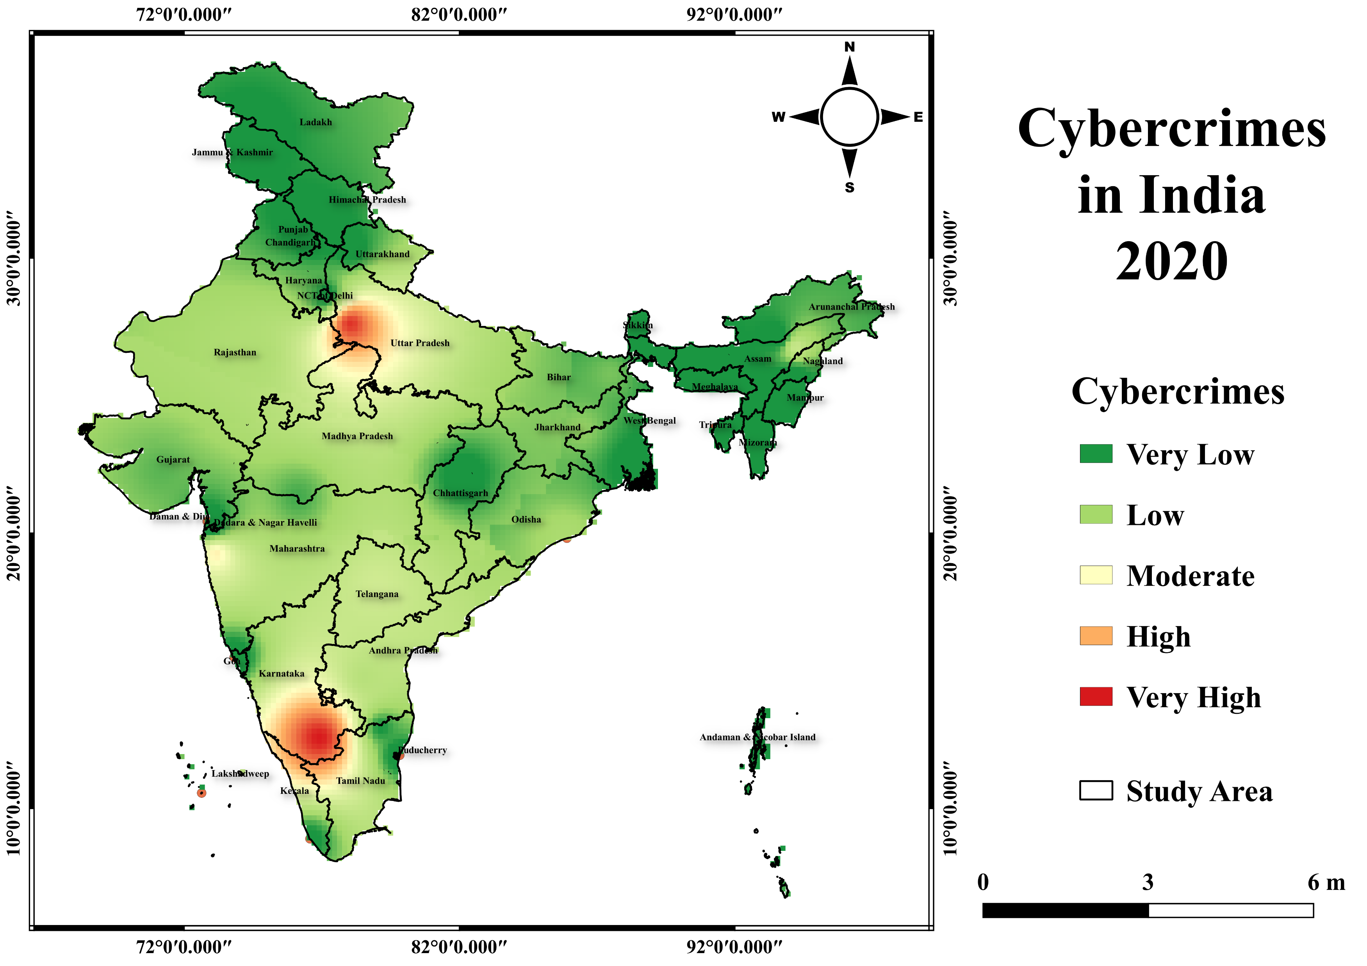
Interpolated map for the year 2020 showing cyber crime values ranging from 0 to 14919
For the purpose of the study, total values were divided in 5 classes as follows:
0-500: Very Low
500-1500: Low
1500-5000: Moderate
5000-8000: High
Above 8000: Very High
Forecast shows Karnataka is leading the way, followed by Uttar Pradesh

Slide 14
Total no. of cases 53161
Rise in no. of Cybercrime
Total no. of cases 12317
In the year 2016, a no. of states namely, Andhra Pradesh, Assam, Odisha, Telangana are found to be lying in the very low range(0-500), due to increased crime rate, now predicted to lie in moderate range(5000-8000) in the Year 2020.

Slide 15
All the states except Goa, Kerala, Manipur, Uttarakhand, West Bengal, Puducherry, NCT of Delhi, Andaman & Nicobar islands, Chandigarh, Dadar & Nagar Haveli, and Nagaland show a rising trend .
The cybercrime no. in India, rose from 12317 (in 2016) to 53161 (in 2020)(as per calculated forecasted values).

Slide 16
CONCLUSION
The maps accurately show how overall cybercrime cases in India will continue to rise.
Lack of cybersecurity in India
With rise in no. of crimes, for law enforcement agencies, geographic information system continues to prove their efficacy to improve crime analytics, reduce the no. of crimes and better protect mankind.
It is truly said “Modern problems require modern solutions”

Slide 17
ACKNOWLEDGEMENT
Primarily, I would like to thank Almighty for being able to complete this project with success. Next, I would like to express my sincere gratitude to OS Geo Korea for providing me this golden opportunity. Also, thankful to Avakaza Geo-Sciences Research Technologies (AGSRT) through which I was able to connect with a wonderful and inspiring mentor Dr. N.N. Salghuna, who introduced me with this opportunity, supported and guided me throughout this endeavour, to whom I’ll be forever grateful.

Slide 18

Thank you

